Slide 1
Little Ones
PowerPoint Template
Exclusively Made for
TheTeacherTreasury.com

Slide 2
5 Things Every Class Should Have
A White/Black Board
Learning Toys
Digital Learning Tools
Proper Lights
A Window

Slide 3
10 Ways To Learn Effectively
In-house Black Board
Learning Toys
You Tube Videos
Teacher’s Homework
Together With Friends
Educational Games
Grandma’s Fairy Tales
Kid’s Magazines
Outdoor Activities
Mom’s Lessons

Slide 4
THANK YOU

Slide 5
Little Ones
Free PowerPoint Template
Exclusively Made for
TheTeacherTreasury.com

Slide 6
10 Ways To Learn Effectively
In-house Black Board
Learning Toys
You Tube Videos
Teacher’s Homework
Together With Friends
Educational Games
Grandma’s Fairy Tales
Kid’s Magazines
Outdoor Activities
Mom’s Lessons

Slide 7
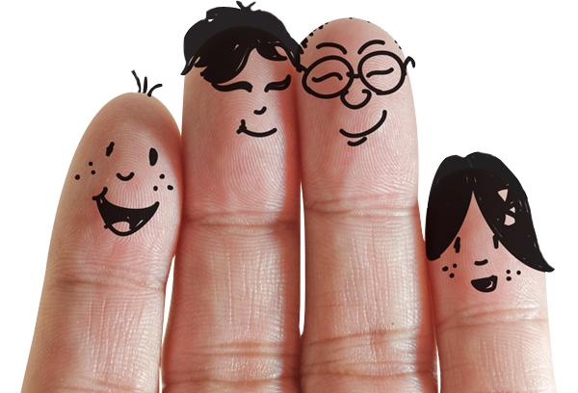
5 Things Every Class Should Have
A White/Black Board
Learning Toys
Digital Learning Tools
Proper Lights
A Window

Slide 8
That’s all folks!

